Slide 1
Implement Data Visualisation techniques using MS Excel
Module Project
Module: NICF Data Queries and Visualization Basics
Course: NICF Diploma in Business Analytics
Start Date :
End Date :
Submission Date : 21/02/19
Learner Name : Lim Qiang Sheng Michael
Enrollment ID :
Presentation Date : 21/02/19

Slide 2
Contents
Document History
Version Number | Effective Date of release | Summary of Included Changes | Author
1 | 13th July 2016 | First Edition | Satya CVS

Slide 3
Contents
Contents
S. No. | Description
01 | Project Overview
02 | Steps for Preparation of Data
03 | Visualization Techniques
04 | Data Set Analysis
05 | Project Outcome

Slide 4
1. Project Overview
Overview of the project
This project takes a look at survey data taken from within an unnamed company with only 3 departments of HR, Sales and R&D. The survey data looks at factors which affect company attrition or turnover. Examples of these factors include, Education, Age, Gender, Distance from home etc.

Slide 5
2. Steps of Preparation of Data
Steps for preparation of data
Steps used for preparation of data or cleaning of data include.
Hiding or removing duplicate data, getting rid of unwanted columns,
Normalization - Using find and replace to change text to numbers to prepare data for Data Analysis.
Using Data Analysis tool to produce a correlation matrix out of all the columns from the attrition data sheet in order to find which factors influence attrition the most.
Further steps taken
Using IF function to sort age into age groups
Converting monthly income to income per annum
Grouping the annual incomes into ranges
This data was then used to create attrition by age groups and attrition by income categories shown in this report below.

Slide 6
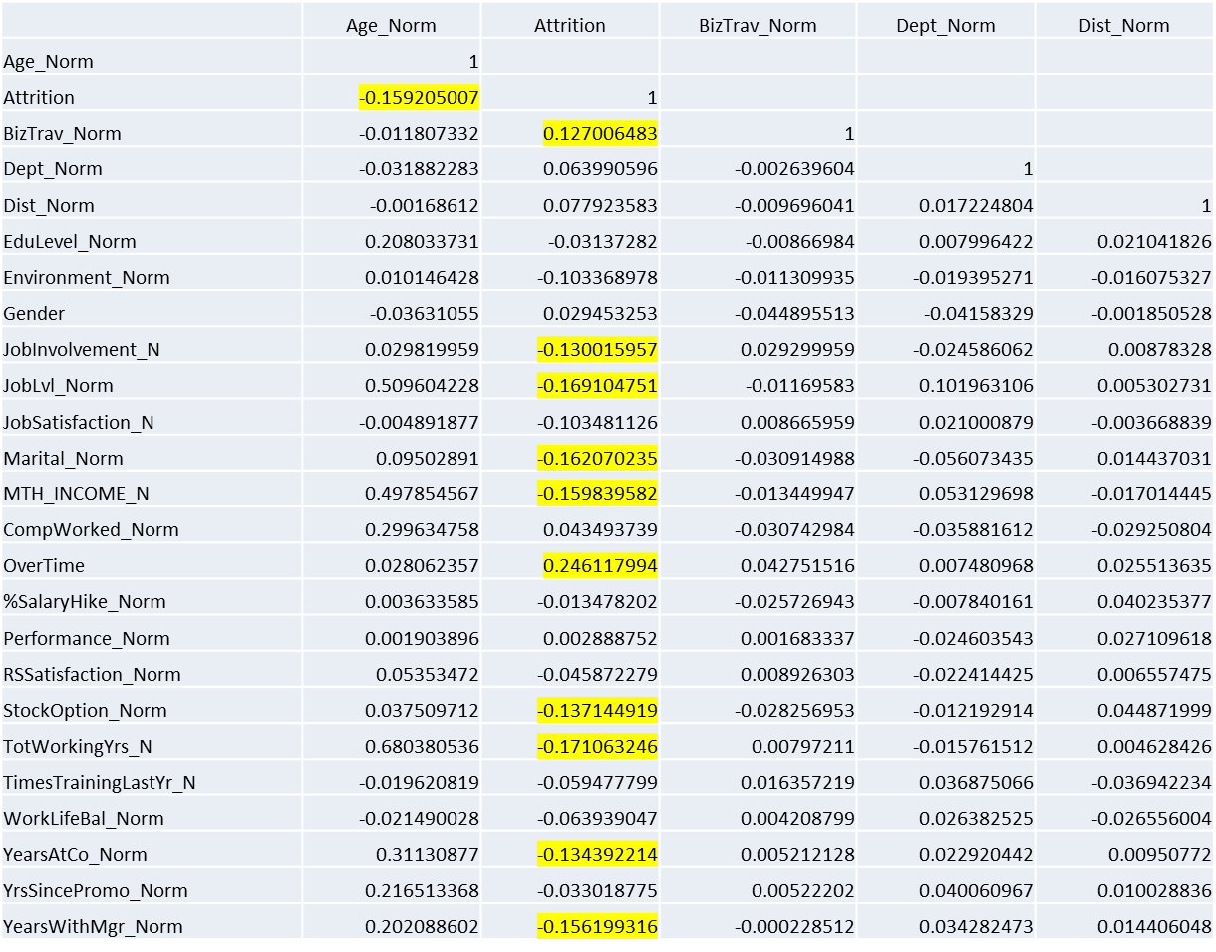
Correlation Matrix
Correlation matrix only shown up to column F

Slide 7
3. Visualization Techniques
List the visualization techniques considered along with justification why they were used or not used
  Pivot Charts using stacked and clustered column
  Pie Charts
  These were the cleanest and easiest to read given the type of data provided.
Scatter charts, line charts and combination charts were too confusing given the data set and the simple statistic tools used.
S. No. | Visualization Techniques Used | Justification
S. No. | Visualization Techniques Not Used | Justification

Slide 8
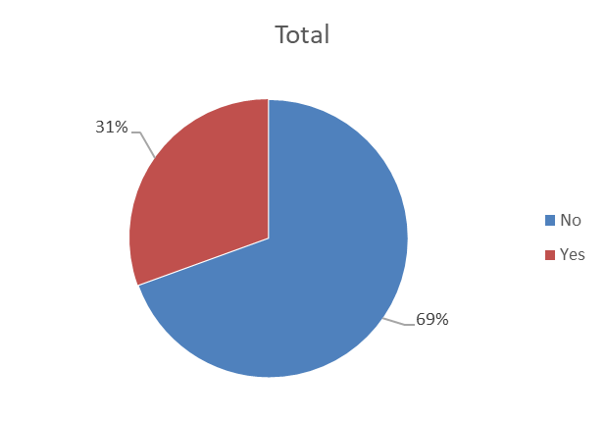
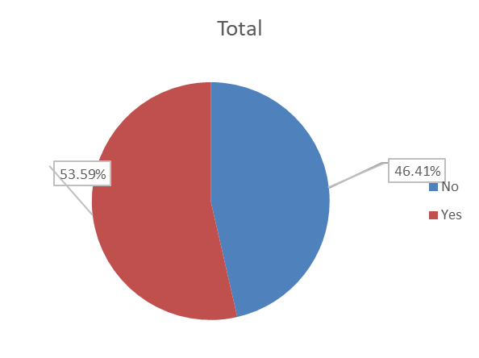
4. Data Set Analysis
Analyse and list down observations of 5-6 strongest factors related to attrition
Out of those who Do Overtime, 31% left the company.
Out of those who left the company 53.9% do overtime.

Slide 9
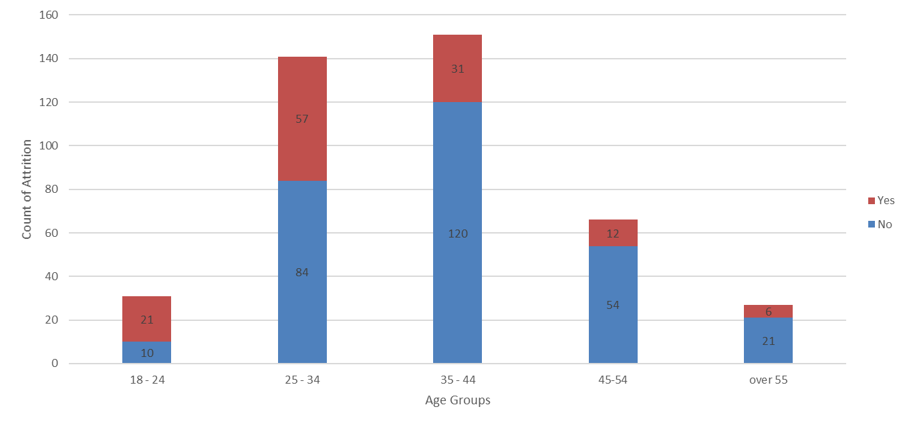
4. Data Set Analysis
This chart shows age groupings and which group has the highest total populations, and also which group has the highest attrition rate. It has also been filtered (by slicer) to show only those who do overtime. In the legend Orange ‘Yes’ shows the count of people who have left the company. Blue ‘No’ shows the count of people who have stayed.

Slide 10
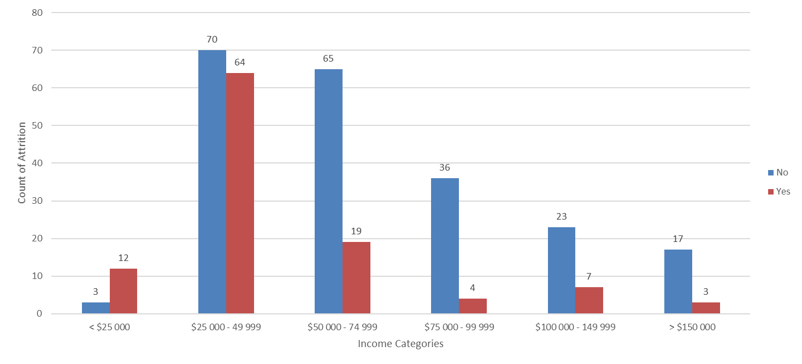
4. Data Set Analysis
This chart shows Income Categories, once again filtered to show only those who do overtime.

Slide 11
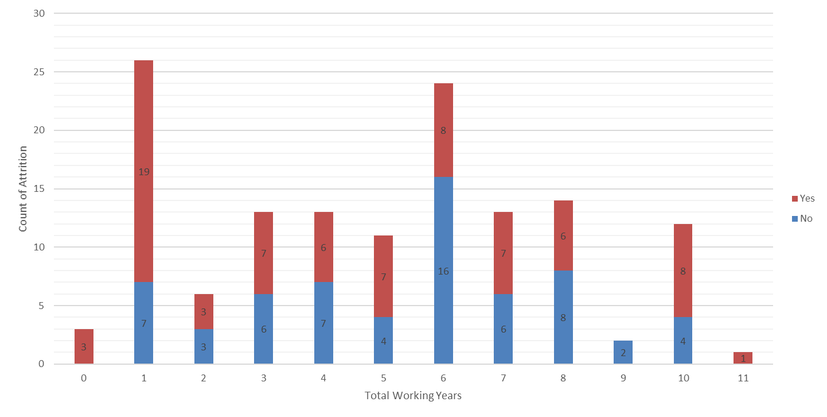
4. Data Set Analysis
This chart shows that many leave in their first year of work, especially after filtering to show only those who work at job level 1, and only showing those who do overtime. From playing with the filters, we also discover that most of the attrition comes from Research and Sales. Strangely if you toggle the slicers to show broader data that shows all the job levels, many people leave in year 10 as well.

Slide 12
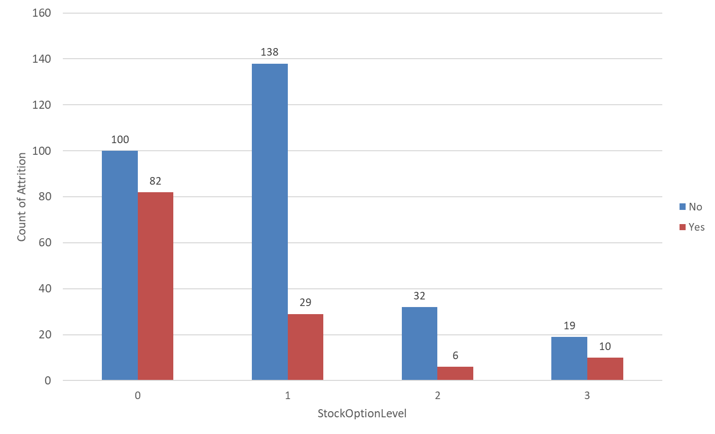
4. Data Set Analysis
This chart shows that attrition is inversely related to stock option level. This relationship is especially true for option levels 0 and 1.

Slide 13
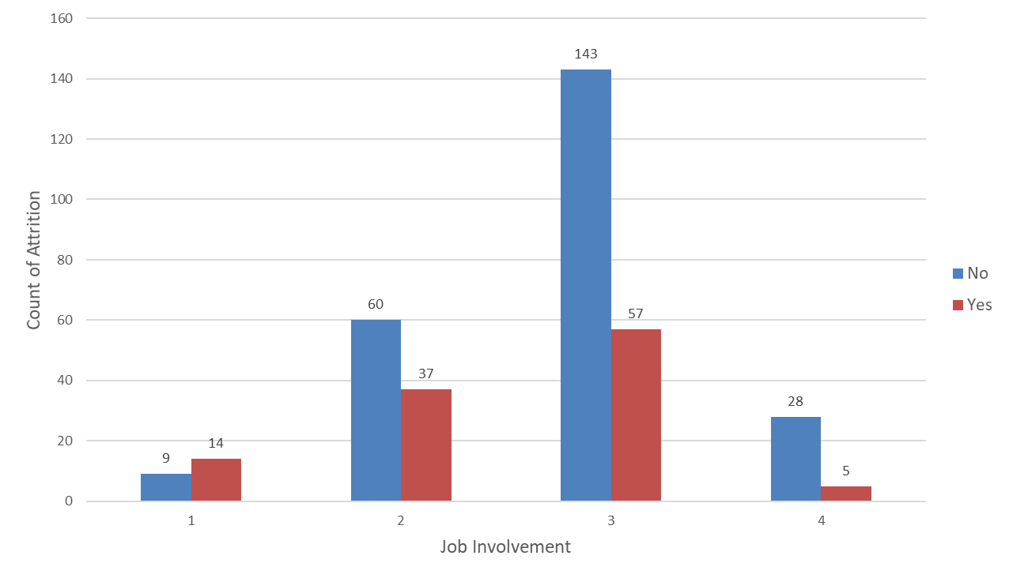
4. Data Set Analysis
This chart shows ratings of Job Involvement, a measure similar to job satisfaction which shows how staff feel that they make meaningful contributions. The heartening thing is that even employees in the high attrition demographic can show high job involvement ratings.

Slide 14
5. Project Outcome
How will data visualisations help management?
A series of sheets have been created, so that data can be easily visualised in the form of simple charts which can be toggled through different perimeters using sliders.
What recommendations can be made to the employer in light of our findings?
  The highest recommendation would be a reduction in overtime for lower job levels
  Perhaps management can look into stock options even for lower job levels
  Also the highest attrition rate was found to be in Research and Sales, it would be good to look at the practices and benefits in these departments as well as to see how much overtime these staff are doing.
  Lastly, there are good signs that the job involvement ratings are ok even when filtered out to show employees between 18-34. If job involvement ratings can be improved, perhaps attrition will be reduced.

